Slide 1

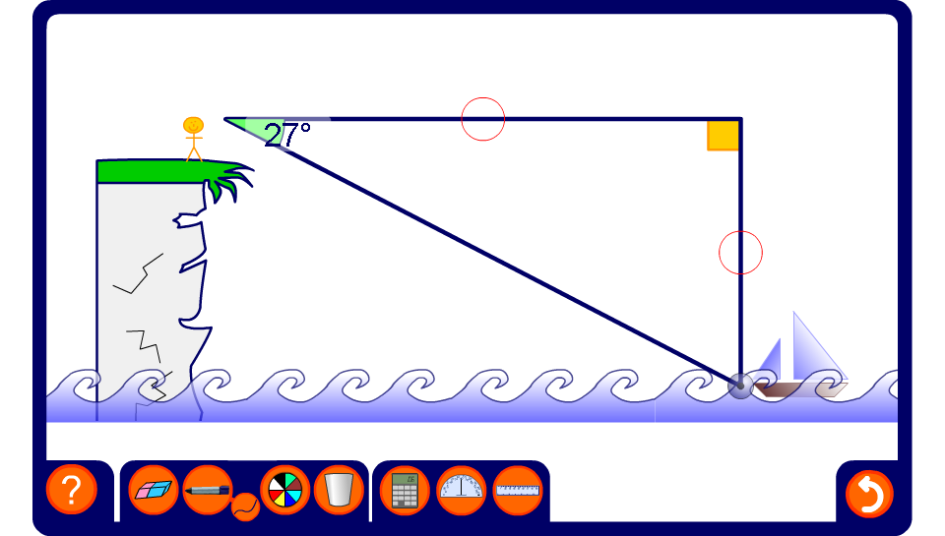


Angles of depression
Notes:
Explain that an angle of depression is the angle made between the horizon and the bottom of an object that you are looking down on.
By measuring the angle of depression from the the top of a cliff, for example, we can apply trigonometry to determine the distance of objects from the foot of the cliff.
Hide either the angle of depression, the distance between the boat and the viewer or the distance between the boat and the foot of the cliff. Ask pupils to use the cosine ratio to find the unknown measurements.
Modify the values by changing the position of the boat.

